Slide 1
DIGITAL EXPERIENCE LAB
PROJECT
TEAM MEMBERS
AthulRaj BC
Denil Tom Jaison
Aleena Benny
Riya George
Rohith Joseph Gomez

Slide 2
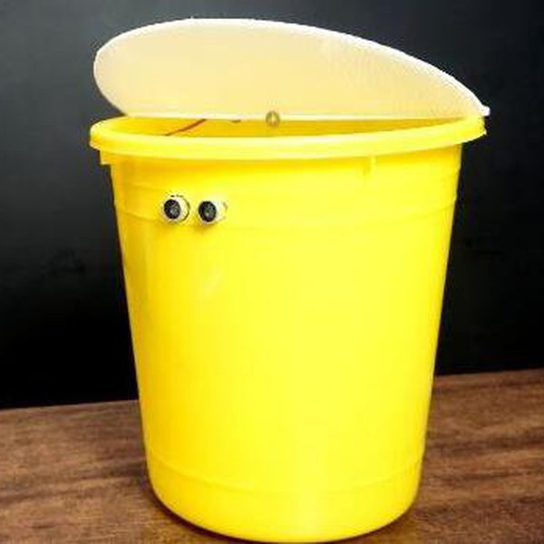
SMART DUSTBIN

Slide 3
WHAT IS SMART DUSTBIN?
A smart dustbin is a normal dustbin that with mounted technology equipments,which
consist of UV sensor,Arduino,Servo motor etc….
It is implemented with a simple working system.
When the person comes closer to the smart dustbin the the dustbin cap will
automatically open for your waste and after some time it will automatically close.

Slide 4
COMPONENTS PRICE
1.Arduino UNO-800rs
2.UltraSonic Sensor Module-130rs
3.Servo Motor-190rs
4.A small Dustbin with hinged lid-150rs
5.Connecting Wires=100rs

Slide 5
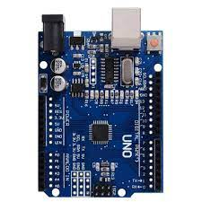
ARDUINO UNO
Arduino is an open-source electronics platform based on easy-to-use hardware and software.
It focuses on using microcontrollers in advanced electronics by building microcontroller boards.
Arduino boards are able to read inputs and turn it into outputs such as activating a motor, turning on an LED.

Slide 6
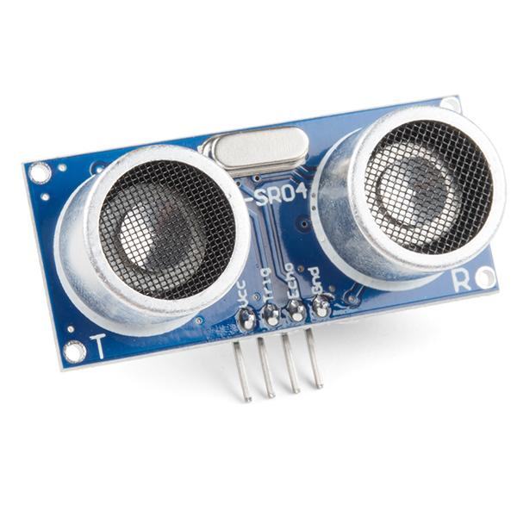
ULTRASONIC SENSOR
An Ultrasonic sensor is a device that can measure the distance to an object by using sound waves.
It measures distance by sending out a sound wave at a specific frequency and listening for that sound wave to bounce back.
By recording the elapsed time the distance is calculated.

Slide 7
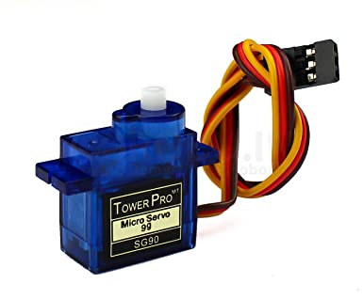
SERVO MOTOR
A servomotor is a rotary actuator or linear actuator that allows for precise control of angular or linear position, velocity and acceleration.
It consists of a suitable motor coupled to a microcontroller for position feedback.
Servo motors are small, have built-in control circuitry and have good power for their size.

Slide 8
CIRCUIT DIAGRAM EXPLANATION
The circuit diagram for smart dustbin contains three main components:
Arduino Uno, Power supply and an Ultrasonic sensor.
The Ultrasonic sensor pins echo and trig are connected to Arduino Uno pins 5 and 6 respectively.
The servo motor data pin is connected to the 9th pin.
The VCC pin is connected to 5V on Arduino Uno and both the grounds are connected together.

Slide 9
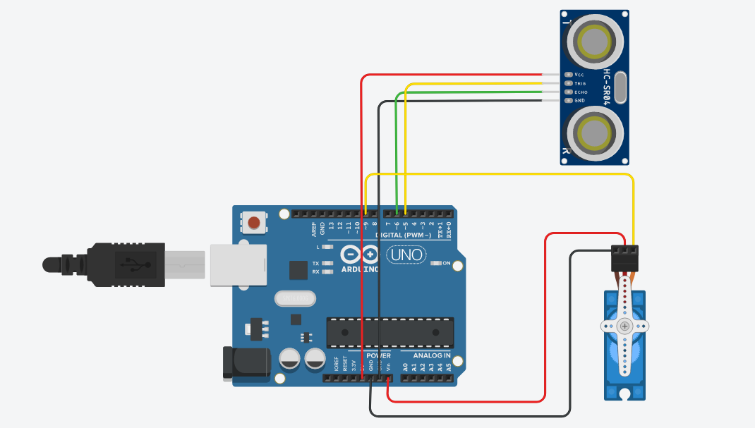
CIRCUIT DIAGRAM.

Slide 10
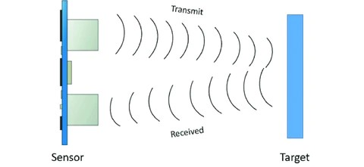
WORKING…
Smart dustbin works on the principle of object detection using an ultrasonic sensor.
The ultrasonic sensor transmits sound waves.
These waves get reflected whenever an object comes into vicinity of the sensor.

Slide 11
The smart dustbin uses an Ultrasonic sensor to detect objects in front.
Then it sends the signals to Arduino Uno. The Arduino understands the signal and sends a signal to the Servo motor which opens the flap on top of the dustbin.
Here we have a program to open the lid for sometime and then automatically closes.

Slide 12
ADVANTAGES
Low operating cost
Low maintenance requirements
Requires manual recharging
Rough action of user may fastly damage the sensors
DISADVANTAGES

Slide 13
APPLICATIONS
Hygienic disposal of waste.
Automatic sensor based operation with zero manual intervention.

Slide 14
THANK YOU…

